Slide 1

POC Design- Health Apartment
Veteran-Facing Services Digital Health Modernization
Sprint 5 | November 30, 2021

Slide 2
Synthesize IA tree test and infuse learnings into Site Map, POC Design PPT, and concepts to address user feedback in Health Apartment POC Design homepage
HIGH
POC DESIGN

Slide 3

Table of Contents
INTRODUCTION
POC Design: Synthesize IA tree test and infuse learnings into Site Map, POC Design PPT, and concepts to address user feedback in Health Apartment POC Design homepage
POC Design: Iterate Health Apartment POC Design homepage wireframes from low to mid level of fidelity for both authenticated and unauthenticated user experiences
POC Design: Review MyVA and prepare for future OCTO engagement with MyVA team
POC Design: Synthesize navigation system research and identify additional impacts on Health Apartment POC Design
POC Design: Define and align on clear acceptance criteria for Health Apartment POC Design and capture in POC Design PPT
POC Design: Infuse approach to developing Health Apartment POC Design with VA.gov user research / testing processes, methods, and tools
Collaboration Cycle: Prepare for "2-Discover" Step in Collaboration Cycle

Slide 4
Research set up
Goal
Methods
Recruitment

Slide 5
Research to validate POC IA and findability
RESEARCH SET UP: Goal
We had a proposed structure for the health apartment. We tested it to find out:
Is the information organized in a way that makes sense to Veterans?
Does what we’re calling things resonate with them?
The tree test also give us a clear, quantifiable baseline that will help us iterate on the design of the health apartment.

Slide 6
We used an asynchronous tree test to understand the discoverability of tasks and to validate the organization of information in the apartment.
RESEARCH SET UP: Methods
The tree test was built in Treejack by Optimal Workshop. To balance comprehensiveness with cognitive load, we decided to test no more than 20 tasks per study. Here's how we prioritized which tasks we should test first.
We used top search terms to define top tasks, assuming that these are high-need, low-discoverability items.
We prioritized tasks / topics that we had questions about.

Slide 7
Tasks
RESEARCH SET UP: Methods
You need to see a podiatrist, but live 110 miles away from the closest VA podiatrist. You want to find out whether you're eligible to see a non-VA podiatrist. (learning about community care)
You want to make an appointment with this podiatrist. (viewing and managing appointments)
You have a 30% disability rating. You want to learn what health benefits your disability rating qualifies you for. (learning about disability benefits)
Your VA doctor prescribed you a hearing aid. After a few months, the battery has died. You want to order a replacement battery. (ordering health supplies)
Where would you order prosthetic socks? (ordering health supplies)
You drove to your primary care appointment at VA. How would you go about getting reimbursed for gas? (requesting travel pay)
You were notified that you have an outstanding amount for a VA appointment. You want to find out how much you owe. (viewing medical copayments)
You need to go to the dentist. How would you find out what coverage you qualify for? (learning about dental benefits)
A Veteran you care for was just diagnosed with PTSD. You want to learn more about this condition. (learning about specific health conditions (i.e., research health))
Your doctor told you that you have high blood pressure and asked you to enter those numbers online between visits. (tracking self-entered health data)
You want to subscribe to the My HealtheVet newsletter. (reading or subscribing to the MHV newsletter)
You had some blood tests done at VA this week and you want to see those results. (viewing labs & test results)
You got married and you want to add your spouse as a dependent. (managing benefits)
Where would you expect to find information about COVID-19 vaccines? (learning about COVID-19 vaccines)

Slide 8
Participants were required to have applied for or be currently enrolled in VA health care.
RESEARCH SET UP: Recruitment
We recruited participants through Perigean for diversity within 5 variables:
User Role
Familiarity with MHV
Number of years with the VA/eras of service
Use of VA Benefits
Caregiver and dependent needs
The insights from this study do not include perspectives of:
Participants using assistive technology

Slide 9
33 participants were included; 16 excluded.
RESEARCH SET UP: Participants
Gender
30 participants identified as male
15 participants identified as female
1 participant identified as other
1 participant preferred not to answer
Age
25-34: 7 participants
35-44: 14 participants
45-54: 5 participants
55-64: 9 participants
65-74: 7 participants
75 or older: 3 participants
Undisclosed: 2 participants

Slide 10
Research activities
Generative research review
Secondary research
Synthesis

Slide 11
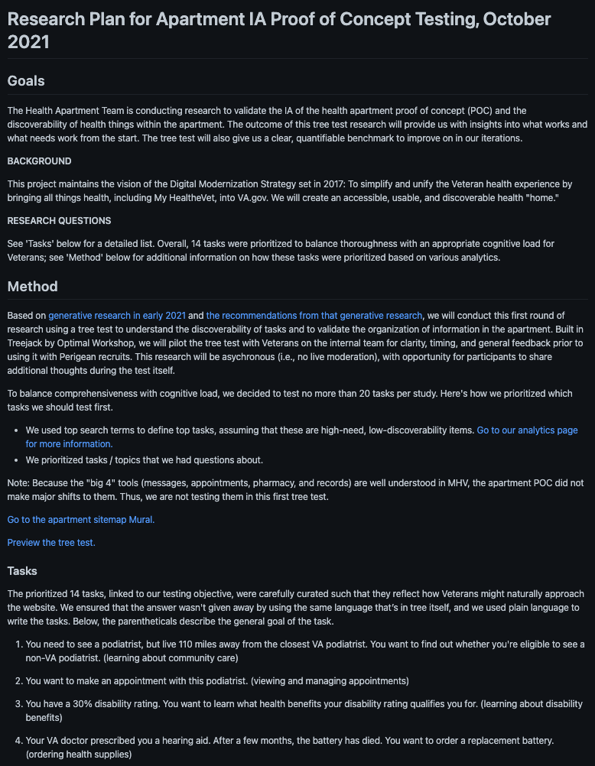
We designed our study around findings from the generative research.
RESEARCH ACTIVITIES: Generative research review
View the research plan here.

Slide 12
We sought and dove deep into the findings from other teams’ research studies, including MyVA 2.0 and the VA Welcome Kit.
RESEARCH ACTIVITIES: Secondary research

Slide 13
MyVA Personalization 2.0 Card Sort
RESEARCH ACTIVITIES: Secondary research
Method: An open card sort asks participants to sort a list of items into groups and then name those groups. This differs from a closed card sort, in which participants have to sort items into a set of provided groups.
Participants: 67
Relevant evaluation criteria:
Frequently used category names — We used the Optimal Workshop standardization feature to group lists of items that had the same or similar names (eg. Medical, Medical Info, and Medical Information).
Lists with different names but similar items — After we grouped categories with similar/the same names, we looked for categories that had different names but similar items in their lists (eg. Medical and Health Care) and grouped them together.
Common cards within groups — Once we had grouped all of the related lists we found, we looked for the most common cards within those categories. For the most part, we ignored outlier cards.

Slide 14
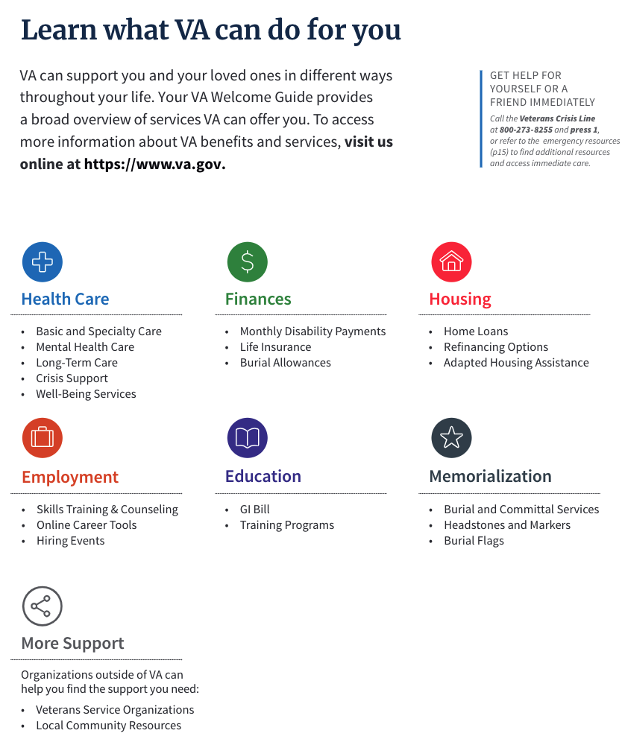
VA Welcome Kit
RESEARCH ACTIVITIES: Secondary research
VA has done a lot of work on grouping and articulating services it offers. We referenced and built off this work, particularly the labels of groups.

Slide 15
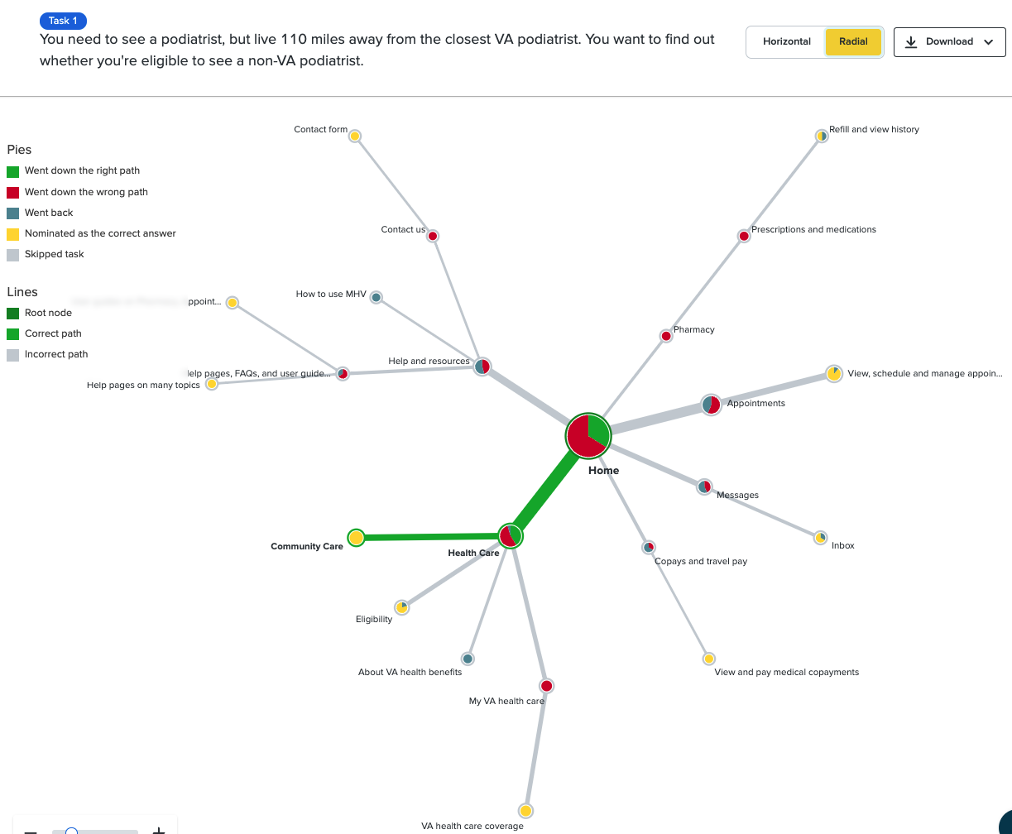
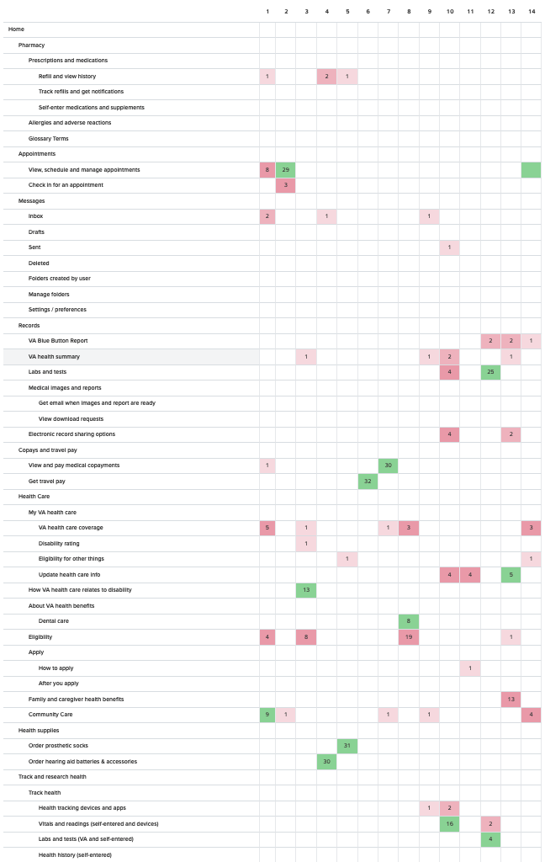
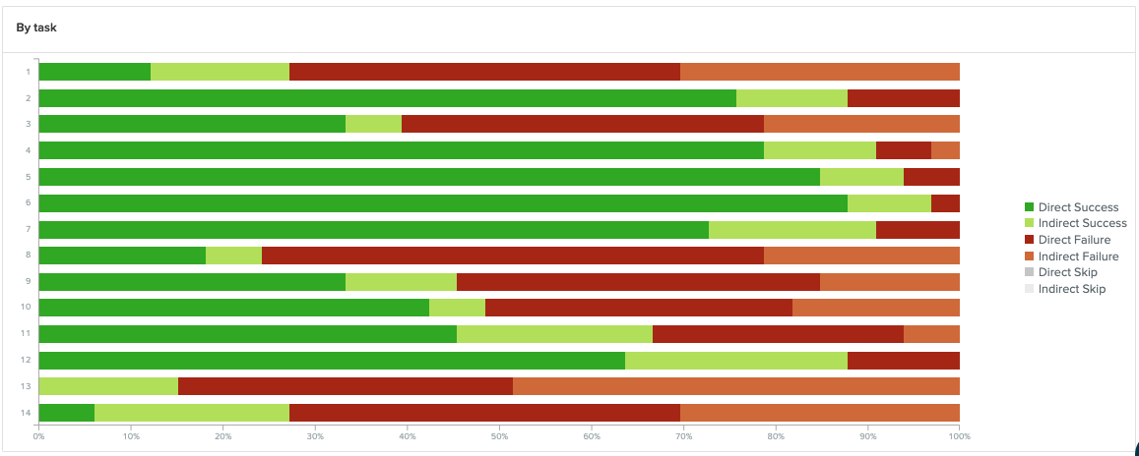
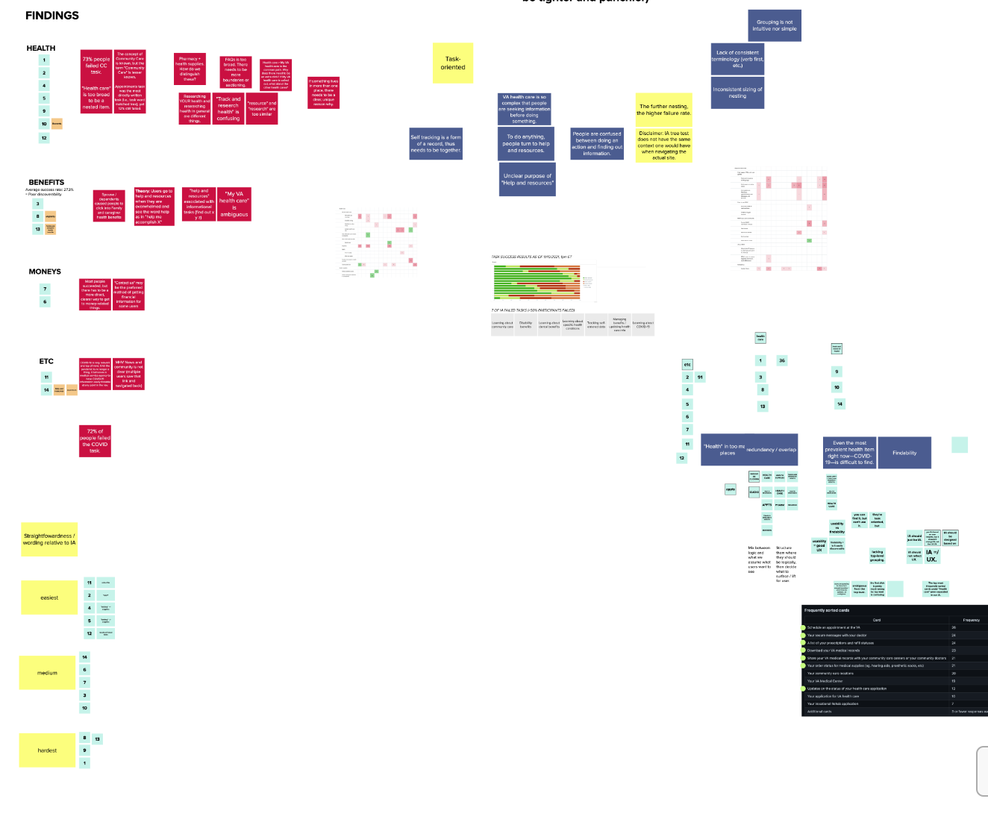
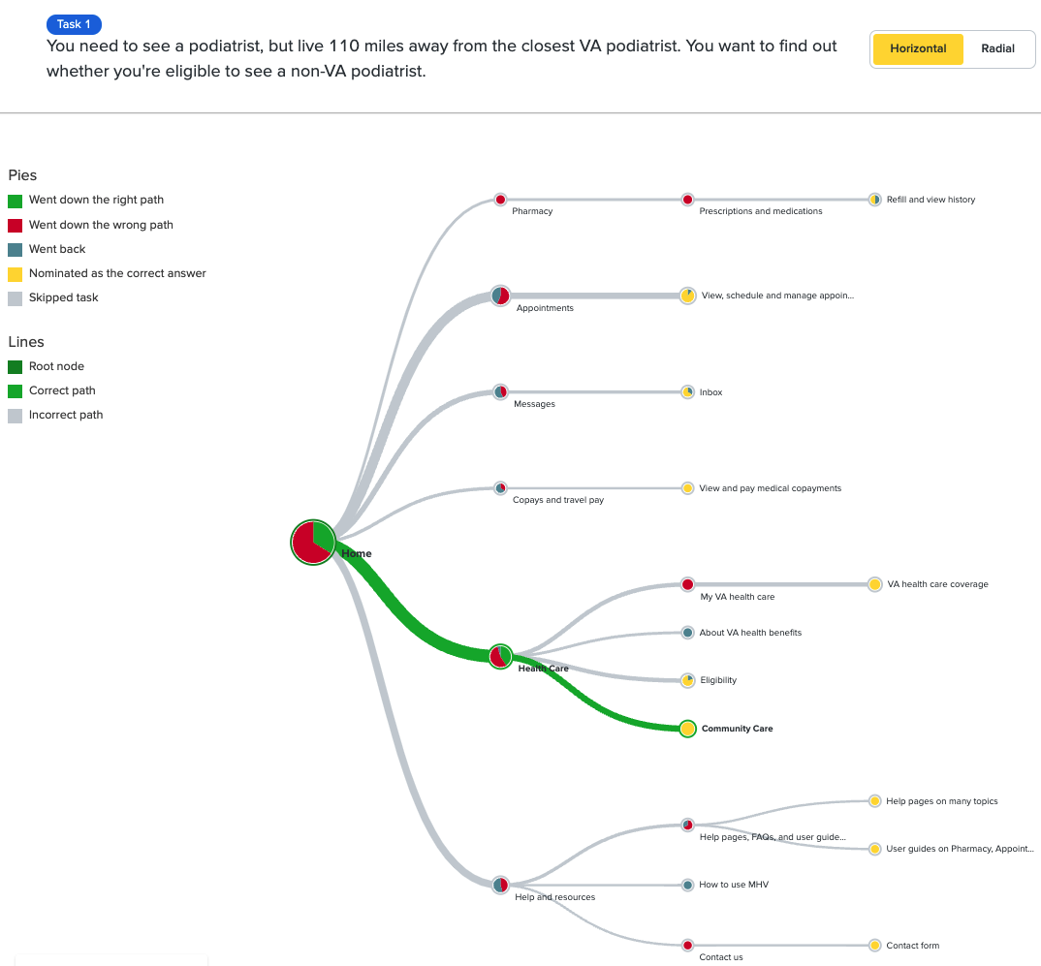
We analyzed the raw data from Optimal Workshop, organized findings based on themes and trends, and synthesized key insights.
RESEARCH ACTIVITIES: Synthesis

Slide 16
Insights and opportunities
Themes
Insights
Opportunities
Design principles

Slide 17
Summary
INSIGHTS AND OPPORTUNITIES
Users are task-oriented but most seek information before doing a task.
The most frequently sorted "Health" cards* were separated in the IA, causing confusion and ambiguity across the top-level sections.
"Help and resources" is not helpful unless users know what specific information it offers.
The deeper the nesting, higher the failure rate.
User experience (UX) and information architecture (IA) are independent of one another and need to be handled separately.
Attempts to show everything at once is actually causing cognitive fatigue.

Slide 18
Users are task-oriented but most seek information before doing a task.
INSIGHT 1
VA health care is so complex that people are looking for information before doing something.
There was inconsistent labeling of sections within the same tier / nest level—some were specific verb-first while others were simply a broad noun.

Slide 19
The most frequently sorted "Health" cards* were separated in the IA, causing confusion and ambiguity across the top-level sections.
INSIGHT 2
The first click was often wrong. Users are guessing because the boundaries between sections isn’t clear (i.e., not unique enough).
*Based on the MyVA 2.0 research.

Slide 20
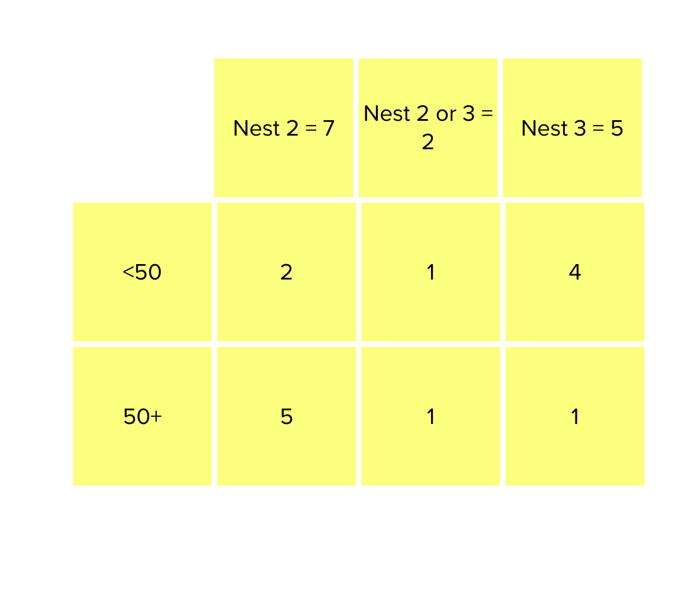
The deeper the nesting, higher the failure rate.
INSIGHT 3
Disclaimer: IA tree test does not have the same context one would have when navigating the actual site.

Slide 21
"Help and resources" is not helpful unless users know what specific information it offers.
INSIGHT 4
To do anything, people turn to help and resources.

Slide 22
User experience (UX) and information architecture (IA) are independent of one another and need to be handled separately.
INSIGHT 5
IA needs to just be IA. How the information is surfaced to the users is another exercise.

Slide 23
Attempts to show everything at once is actually causing cognitive fatigue.
INSIGHT 6
We had 322 total people view the card sort, and 255 abandoned the sort. Of the 67 people who took the card sort, 26 rated the sort as "Very Difficult" (8 people) or "Difficult" (18 people), though it's worth noting the other 41 participants rated the card sort as "Neither Easy or Difficult" (30 people), "Easy" (8 people) or "Very Easy" (3 people).
But it wasn't just the high abandon rate or the amount of people who rated the sort as difficult that clued us into participants having found the sort to be challenging.
With 45 cards, the average number of categories created was only 4, even though we expected this information to be sorted much more granularly. Likely, there was some level of cognitive fatigue that set in with so many cards, resulting in nonsense category names, like numbers, question marks, and at least two people who "completed" the sort by putting all 45 cards into one list.

Slide 24
Additional Observations
Why didn’t this IA tree test build off the MyVA card sort findings? (Excerpt: “When we have a more defined/proposed IA, test that IA again via either a closed card sort or tree testing.”)
Need to verify that terms most accurately represent Veterans’ mental models.

Slide 25
HMW...
OPPORTUNITIES
HMW centralize where users self enter information?
HMW differentiate content by informational vs. actionable?
HMW build an IA that supports users' intentions—to learn or do?
HMW put the right information (content) in the right place (IA) at the right time (unauth vs. auth)?
HMW give users help and guidance for specific tasks / items?
HMW only show the most important and relevant information for users such that it is unique to the other government service? (re: items that involve other government services (e.g., finance <> pay.gov)

Slide 26
Iterate Health Apartment POC Design homepage wireframes from low to mid level of fidelity for both authenticated and unauthenticated user experiences
HIGH
POC DESIGN

Slide 27
Captured Learnings
Focus on making unauthenticated content informational
Organizing informational content to make it easily distinguishable from tasks
Need to make sure things fit in design system and are technically feasible
Important to distinguish between VA Health Care, Community Care, and My VA (IA concept 3)
VA is unique in having a lot of self entered health data living alongside data from labs, hospitals, etc.
This can confuse users because it is unusual/unexpected when compared to other health care services
The key in concept 2 on next slide indicates the separation of these types

Slide 28
Link to Mural
New IA Concepts
https://app.mural.co/t/innovationboards1199/m/innovationboards1199/1637193544636/1f9cdf6afcc3fd7bb8d2f8ba851a6041353abec1?sender=u257b57923703399236fc7616

Slide 29
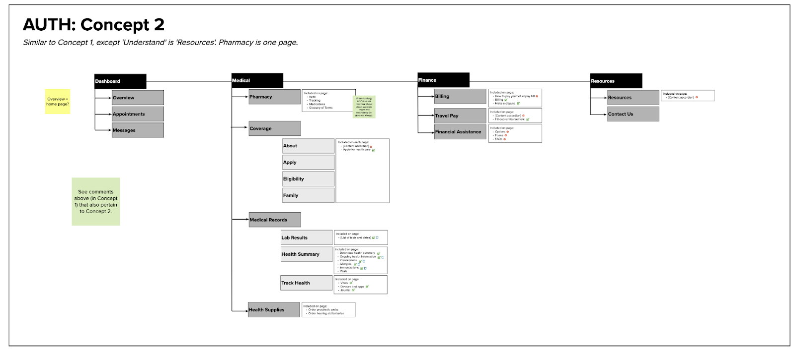
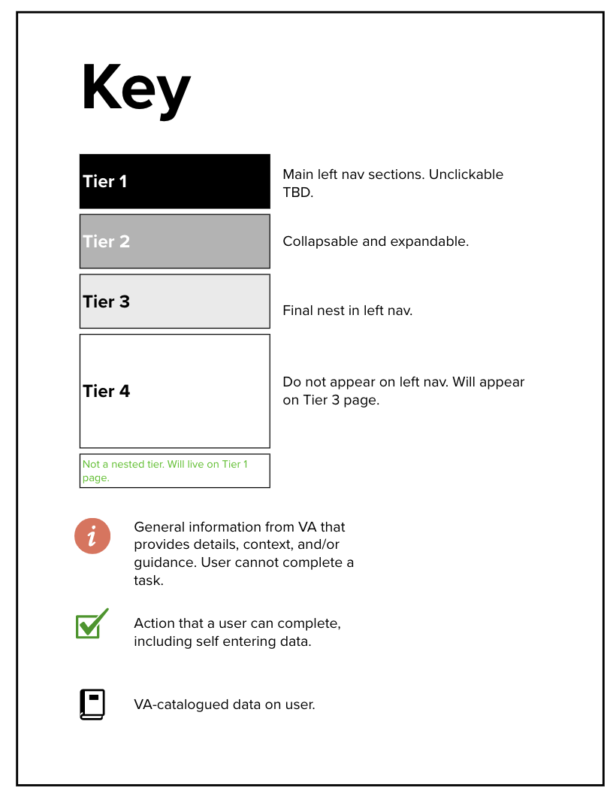
IA Concept 2
New IA Concepts

Slide 30
IA Concept 2: Description
New IA Concepts
Evolution of Concept 1 (from previous sprint)
Removing health care as top level nav since it was confusing users per IA tree test results
Using ”medical” instead of health care per card sort results from myVA
Dashboard surfacing popular tasks (appointments and messages) as inspiration from myVA research results (veterans want their tasks to be front and center)
Accounting for users without health care in IA needs more consideration
Prioritizes point 2 in VA Design Principles: keeping things simple by limiting the number of categories

Slide 31
IA Concept 2: Future Tests
New IA Concepts
Is “medical” as a top level nav item too similar to “health care” and likely to cause the same confusion?
Will users be looking for ”benefits” instead of “coverage” ?
Best title for resources section (we know help is confusing based on IA tree test results but the “best” alternative is unclear)
“Dashboard” category may create confusion with myVA – possible solutions include linking to myVA, changing the title, or fusing concepts together

Slide 32
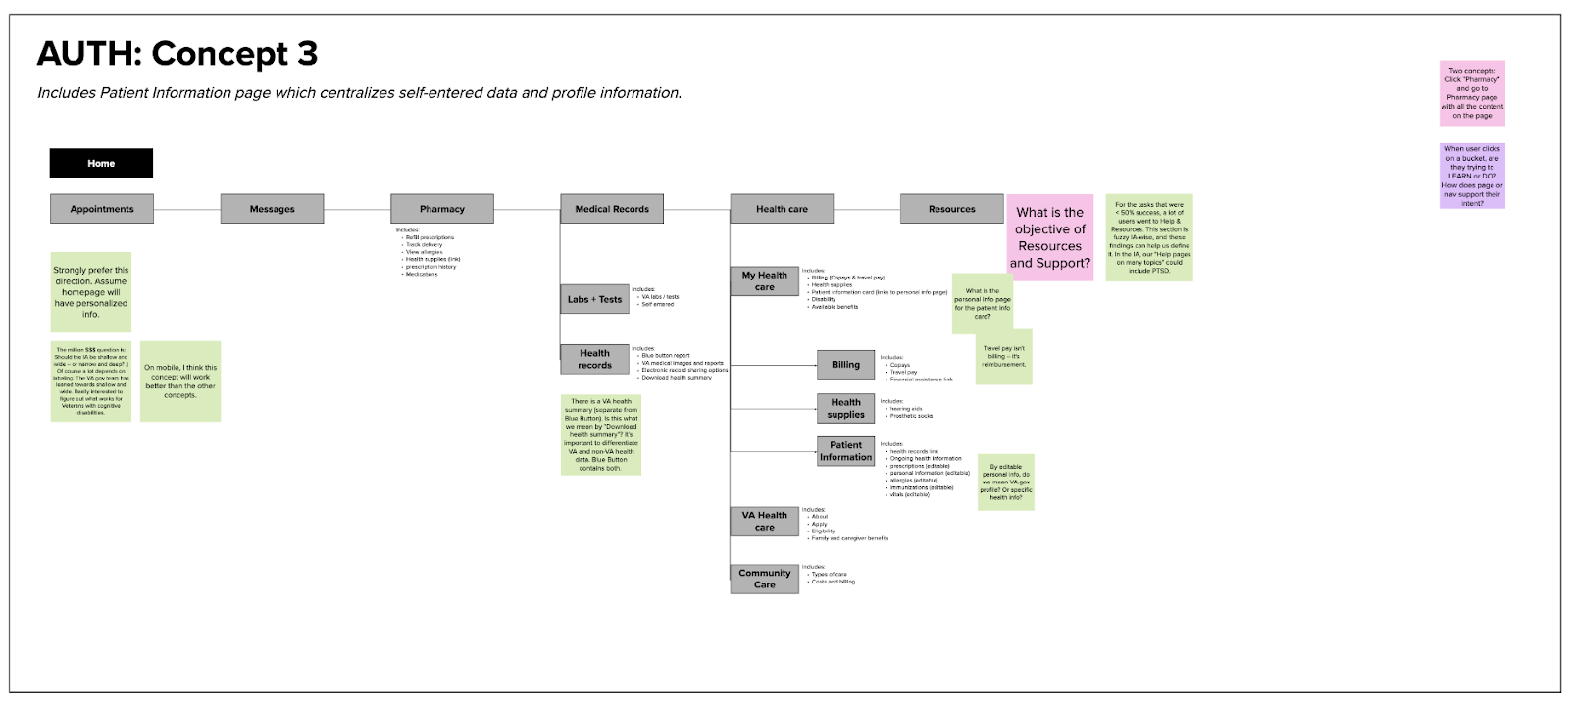
IA Concept 3
New IA Concepts

Slide 33
IA Concept 3: Description
New IA Concepts
More top level categories preserves the sections that had high success rates in IA test
Home page will include personalized info (see wireframes section)
Distinguishing between self entered health data and other health data via “patient information” section under health care
Distinguishing types of health care info (community, VA, personal)
Need to move “travel pay” outside of billing section since it is reimbursement (are there other types of reimbursements?)

Slide 34
IA Concept 3: Future Tests
New IA Concepts
Health care as the top level navigation category could pose a problem in light of the IA tree test results.
Possible confusion separating medical records from health care section (since medical and health care are synonymous)
What makes the most sense in the resources section keeping in mind veteran’s distinction between informational content and task-oriented content
Making Health Supplies available from within both the Health Care section and within Pharmacy.
Patient information as the name for a centralized location to update Profile information, preferences, and self-entered data (labs, vitals)

Slide 35
Impacts/Changes
Some deviations from design system (larger icons, full width buttons, cards with different style of header)
Significant changes to IA, changing top level nav based on IA Tree Test results.
Example: Finance, Health Supplies, Patient Information are located under My Health Care, within the Health Care section.

Slide 36
Concepts to Address User Feedback
IA concept Two:
Changing ”plan” to “coverage”
Changing “copay” to “billing”
Including a design for users who don’t have health care
Sticking within the design system as much as possible (using VA sketch files)
IA concept Three:
Changed “Billing” to “Finance”
Health Records section includes the Blue Button report, VA Medical Images and reports, Electronic record sharing options, and Health Summary in a simplified page. (Having a single page for each of these items when the page content is almost identical is redundant.)
Patient Information page to centralize where the user enters their information
Patient Information Card to show personal / patient details at the top of the page (MyVA Redesign research shows that users like seeing their disability rating at the top of the page with their name)

Slide 37
Recommended next steps
Everything mentioned under IA testing sections for each concept
“Resources” vs “Information” as header for Contact Us and Resources (we know “help” might be problematic based on IA tree test results)
Test alternative wording, especially in the case of sub nav adding words such as “medical” and ”health” – ie “health supplies” vs just “supplies”

Slide 38
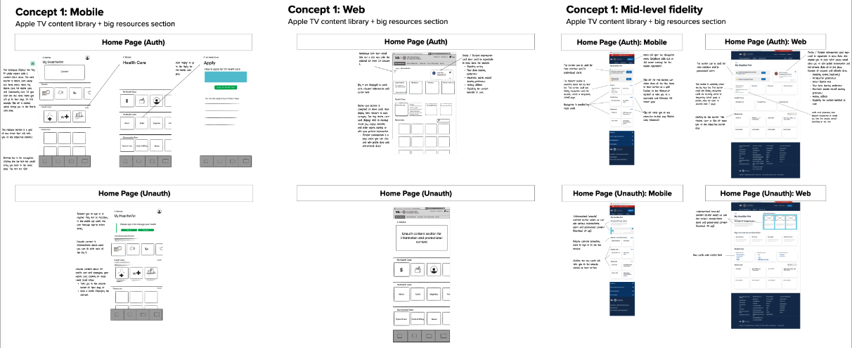
Concept 1 Wireframes

Slide 39
Concept 1 Description
New IA Concepts
Focus on personalization for authenticated users by:
Showing recently visited content at the top
Displaying items in progress (applications, claims) surfaced at the top
Patient Information displayed at the top of the page in a card that shows disability rating, coverage they are enrolled in (health & dental)
Edit button on Patient Information card directs users to a single page where they can view their information (profile, VA, medications, self-entered data)
Navigation (inspired by Apple TV concept)
Big 4 surfaced near the top
Mobile friendly design to pan through sections quickly (need to test horizontal scroll)
Resources has the capacity to surface a lot of different relevant information in clearer/more specific categories
Health Care broken down into three sections: My Health Care (need to test this name), VA Health Care, Community Care
Benefits and Disability is located within the Health Care section under My Health Care, and also accessible via resources / search
Simplified presentation
Unauthenticated content is simplified and informational, clearly communicating the need to sign in order to complete tasks.

Slide 40
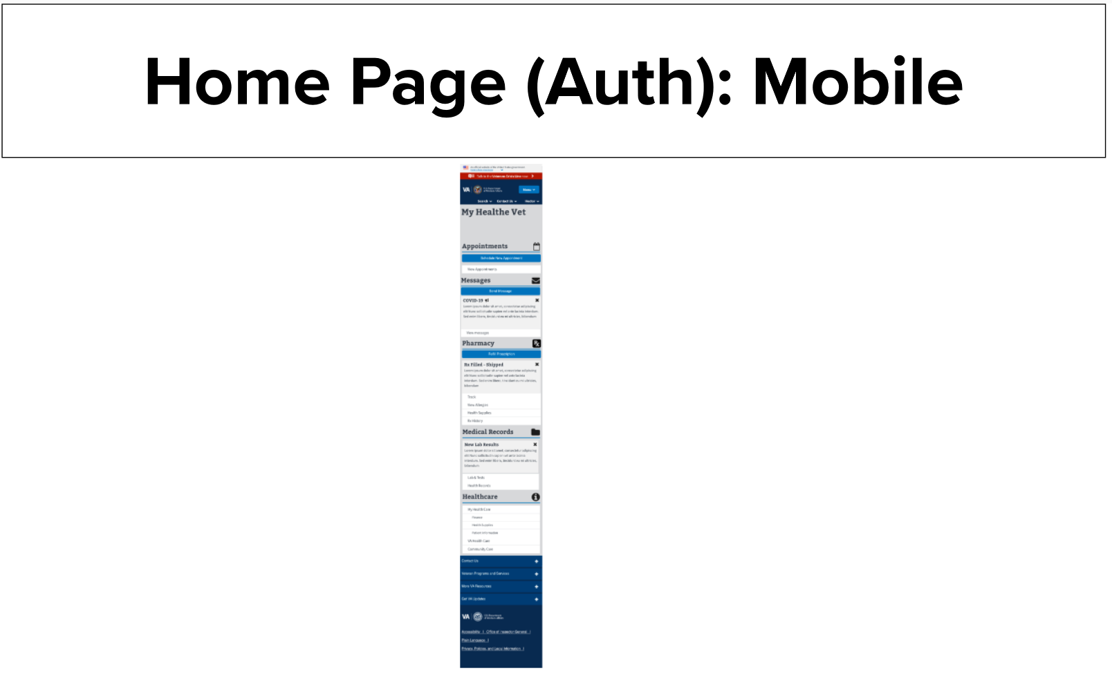
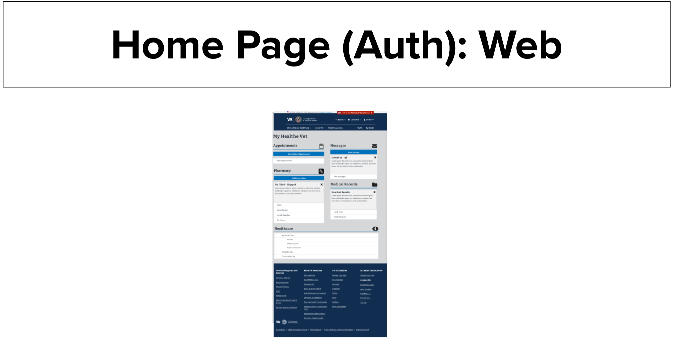
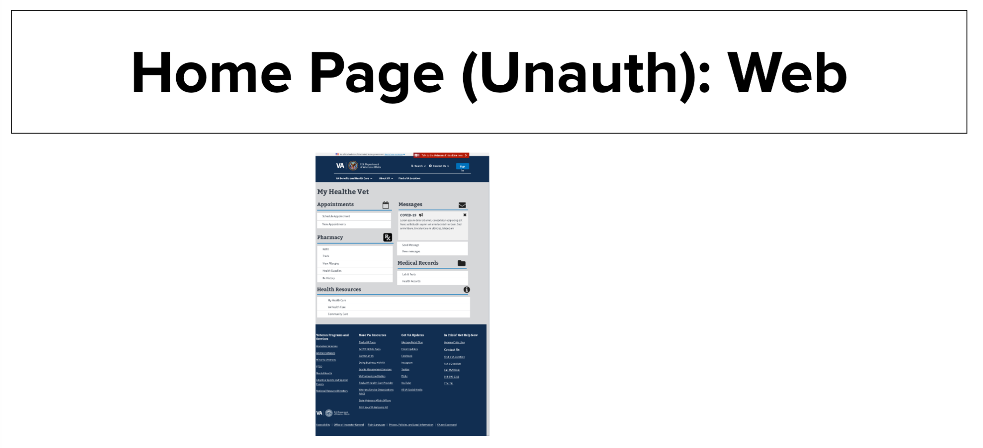
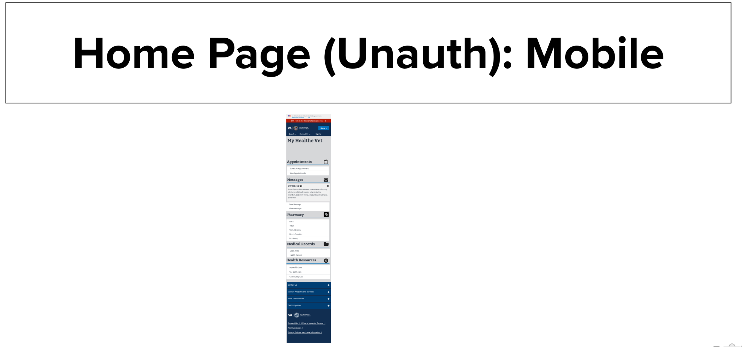
Concept 2 Wireframes

Slide 41
Concept 2: Descriptions
Concept two strongly encourages users to log in prior to entering the Health Apartment.
Enforcing login enables us to provide the user with a task oriented experience along with leveraging data to only surface items that are relevant to the user.
This concept also incorporates an onboarding process (not shown in wireframes) on the user's first login to capture any cognitive disabilities, preferences, and interests to enable us to provide a personalized, simple experience to the user.
This concept differs from the others by displaying time sensitive notifications in their respective sections, rather than displaying all of them at the top. This decision was made based off of the MyVA 2.0 personalization research which suggested that users want to see prescription related notifications within pharmacy rather than seeing the notification once at the top, and again in pharmacy (for example)

Slide 42
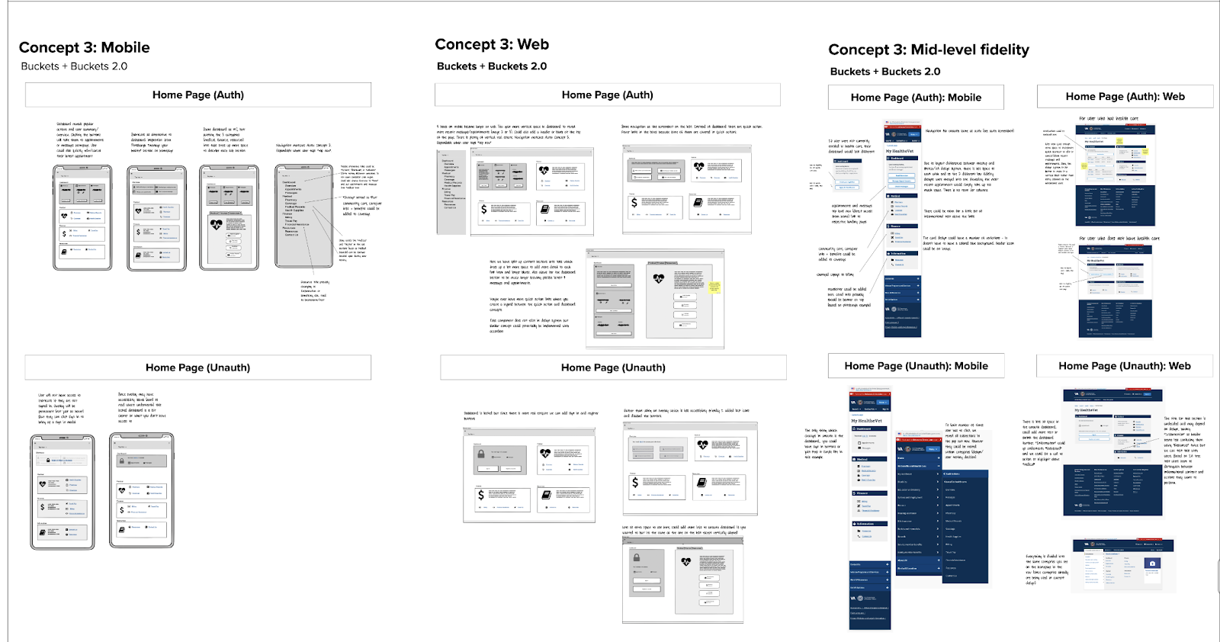
Concept 3 Wireframes

Slide 43
Concept 3 Description
New IA Concepts
Inspiration taken from concept 1 and Pittsburgh VA design
Dashboard section includes personalized content (recent appointments, messages) with quick actions in web view
Takes into account users without health care (alternate dashboard design)
Utilizes a lot of icons in the interest of accessibility/quick scanning

Slide 44
Link to Mural
https://app.mural.co/t/innovationboards1199/m/innovationboards1199/1637339373869/778cf4f440b9a4e21e1eb3890fdf0bae951074d0?sender=u257b57923703399236fc7616

Slide 45
Review MyVA and prepare for future OCTO engagement with MyVA team
HIGH
POC DESIGN

Slide 46
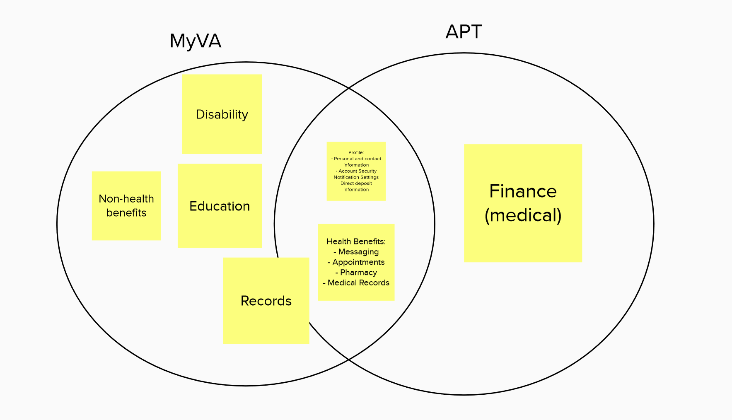
MyVA and APT (Concept) Overlap
Observations:
Massive potential overlaps and redundancies between MyVA and the APT concept (as currently constructed), including messaging, appointment scheduling, and applying for health benefits
"Profile" is also an area of concern, as having two different profiles in two different pages could confuse users
Types of records in “Records” section should be specifically called out to avoid confusion

Slide 47
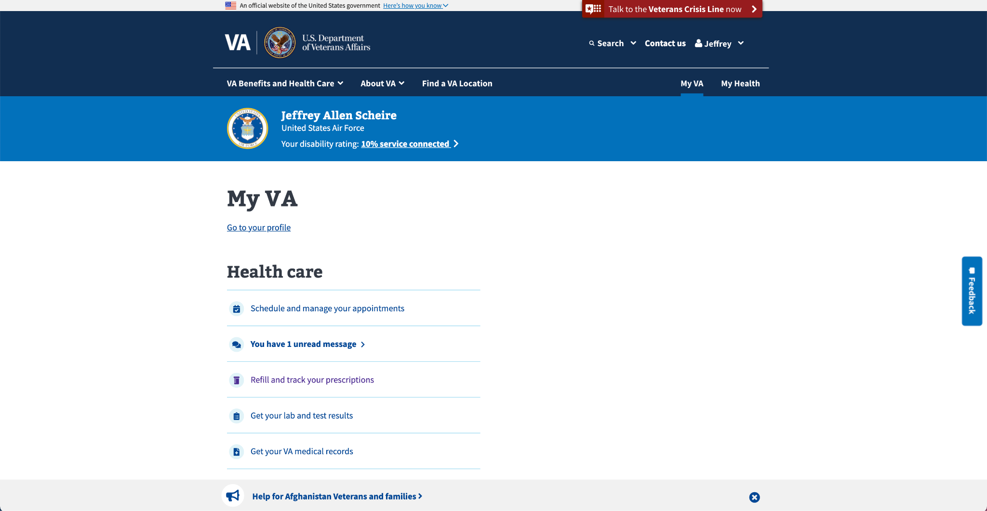
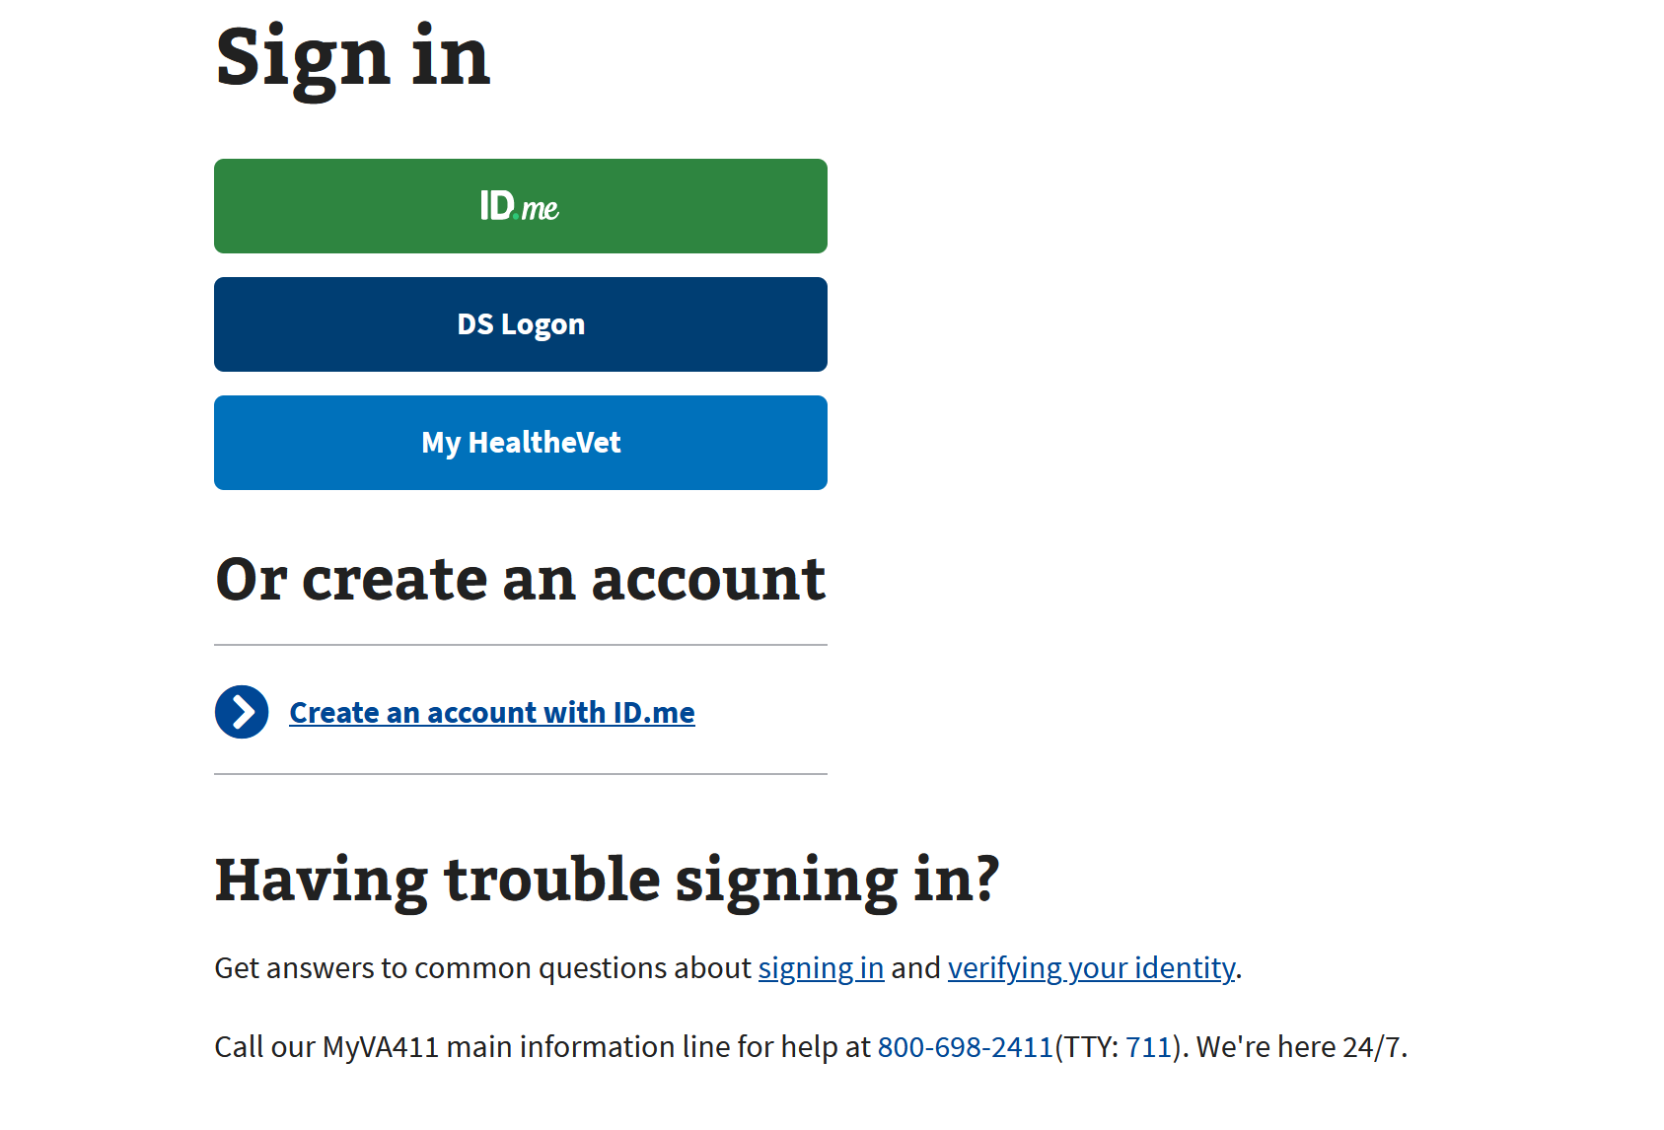
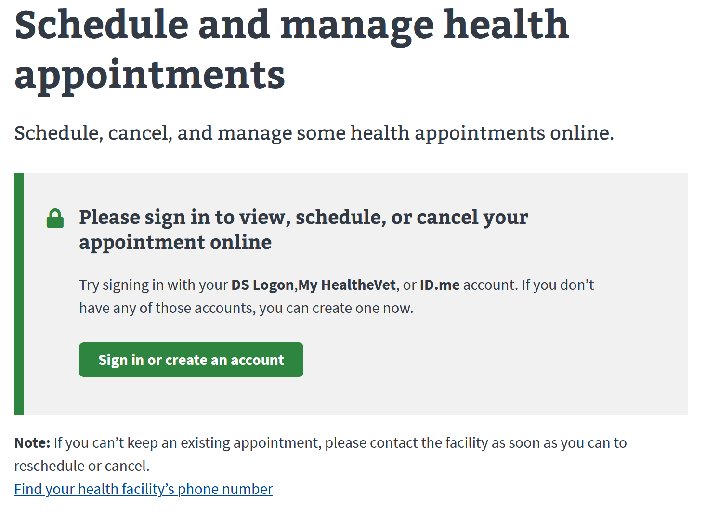
MyVA Auth/UnAuth Observations
Currently, health care is the first item a user sees when they log into their MyVA account. There should be design consistency between MyVA and the apartment so the user doesn’t get confused on which to use.
There’s nothing notifying the user that they have one unread message, save for the bold second item. The apartment should have a more immediately apparent notification.
UnAuth is blanketed with text after sign-in prompt
No sign-up prompt

Slide 48
MyVA/APT Questions and Proposals
Questions
Where is MyVA in the redesign process?
Will APT direct to same appointment scheduler as MyVA?
Will APT Messaging direct to/use same MHV tool as MyVA?
Will MyVA and APT eventually merge?
Proposal
“Show-me” session with MyVA where MyVA and APT each share design plans and roadmaps to find areas of commonality, potential collaboration and overlap risks

Slide 49
Synthesize navigation system research and identify additional impacts on Health Apartment POC Design
HIGH
POC DESIGN

Slide 50
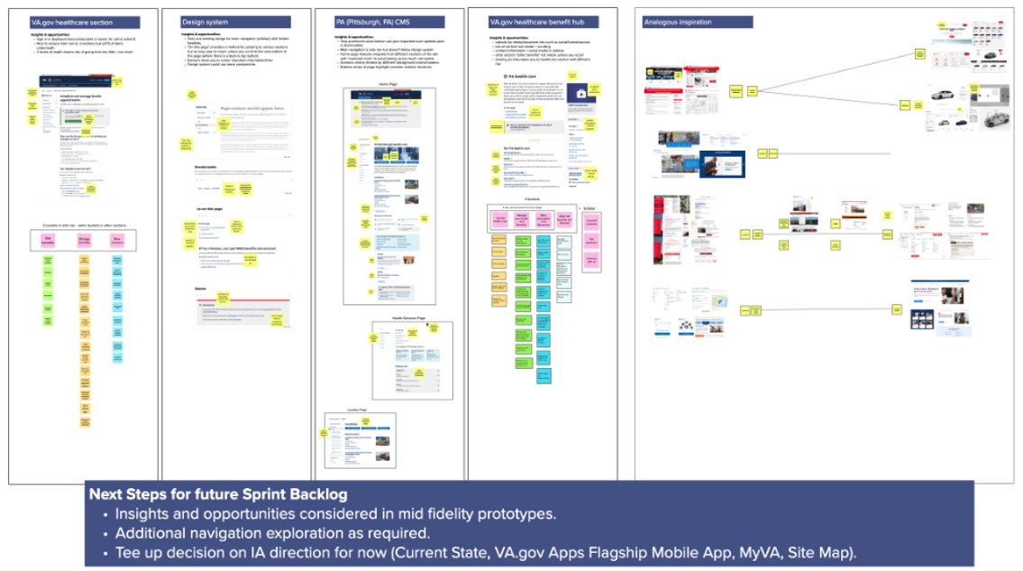
Learnings
Synthesized research into navigation system and uncovered insights, design opportunities, and impacts on Health Apartment POC Design(e.g., homepage and landing pages for auth and not auth key features)
Please refer to IA Design chapter in PPT

Slide 51
Define and align on clear acceptance criteria for Health Apartment POC Design and capture in POC Design PPT
MED
POC DESIGN

Slide 52
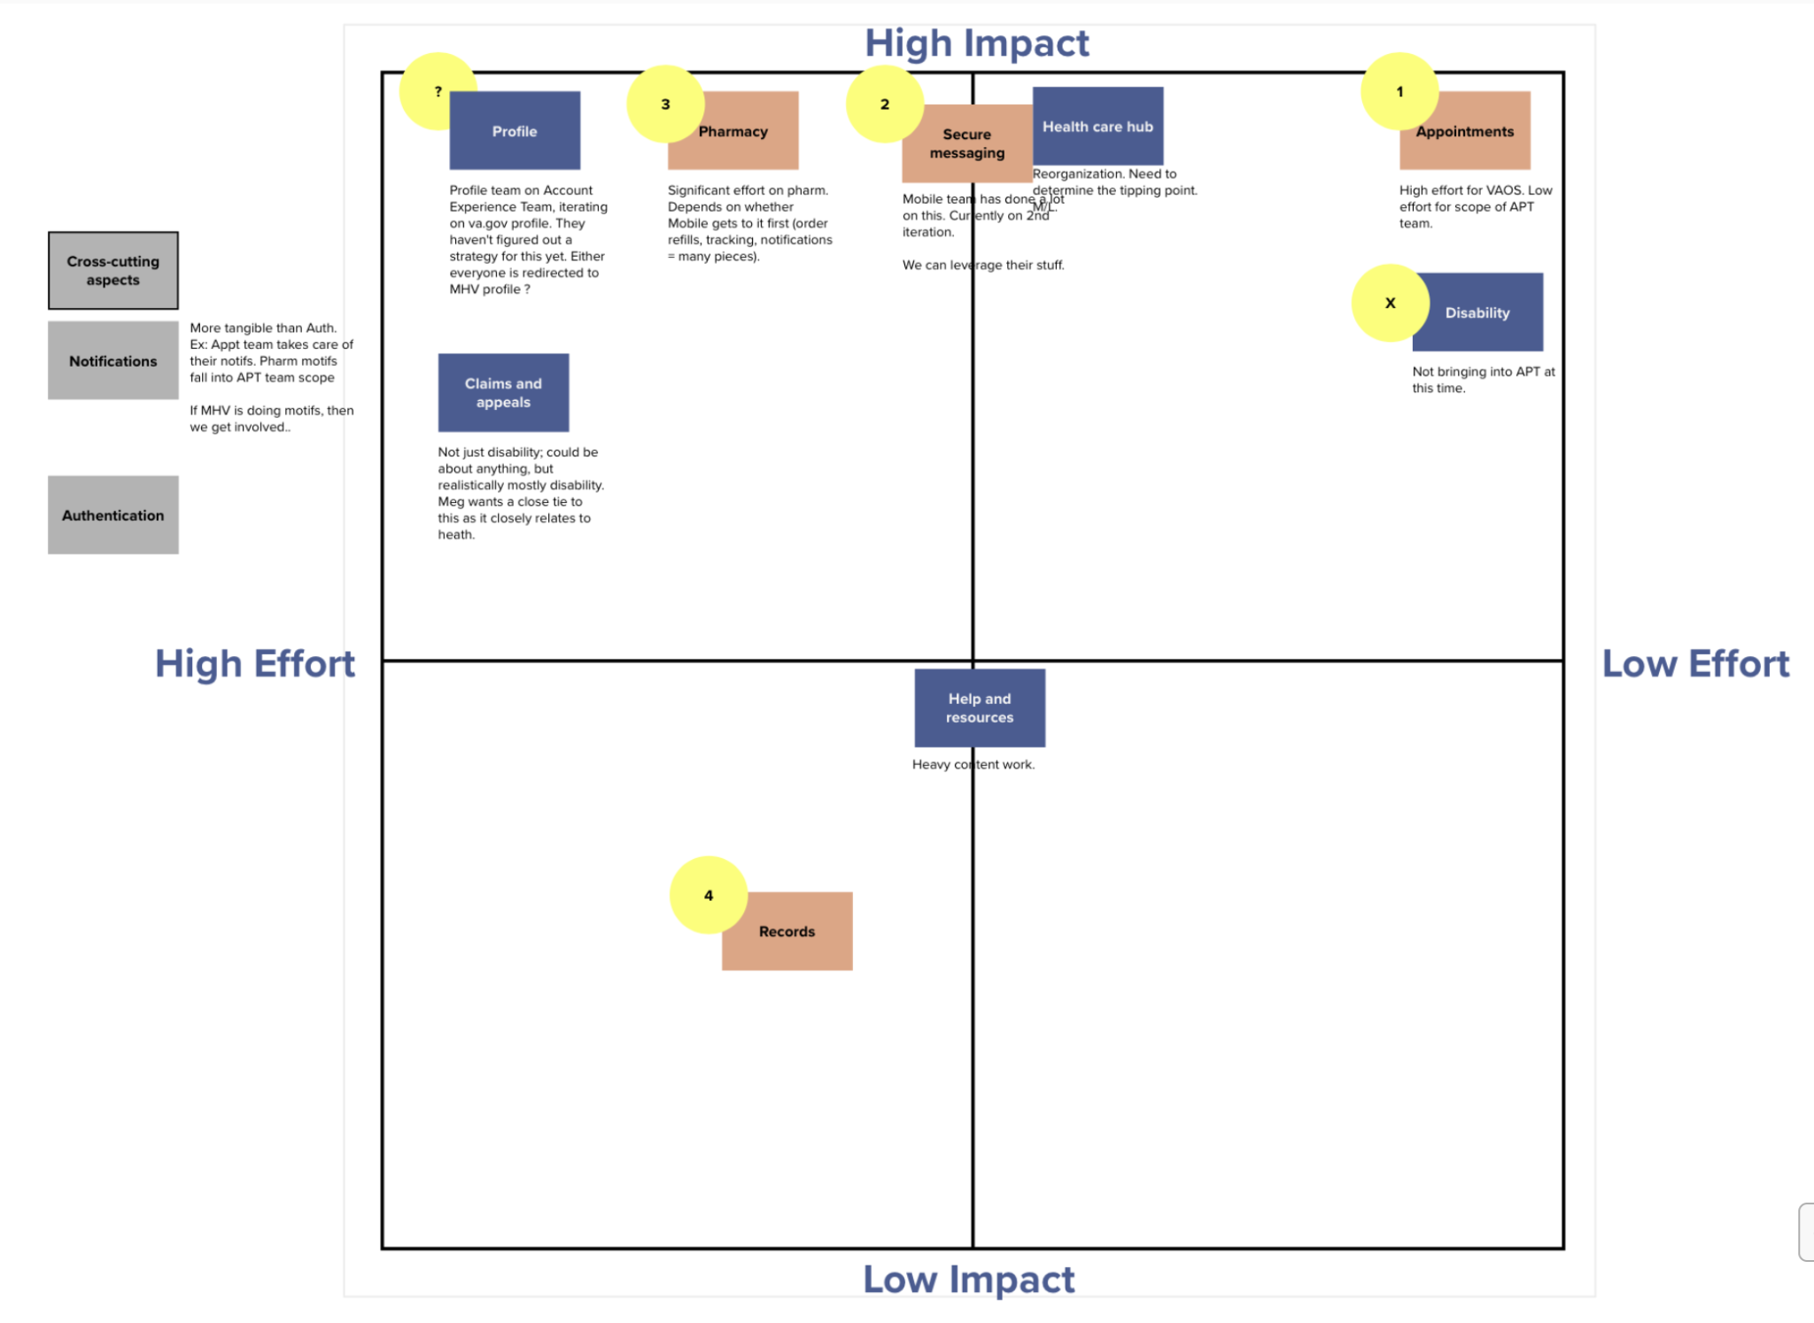
POC Design Priority
The proposed features for the POC are:
Homepage
Appointments (scheduling)
Secure messaging
In October, MO conducted a working session with Meg and Lauren to map out priority areas for the POC using an Effort/Impact evaluation. We used that meeting, as well as user research previously conducted by both MO and the VA, as our North Star to prioritize POC elements.

Slide 53
POC Design Priority: Remaining Questions and Next Steps
Questions
Where and when is the handoff between Apartment and VAOS?
What is our direction on navigation?
Next Steps
Prioritize and map wireframe creation order

Slide 54
Infuse approach to developing Health Apartment POC Design with VA.gov user research / testing processes, methods, and tools
LOW
POC DESIGN

Slide 55
POC Design (Implement VA research approach)
We implemented the VA’s research approach, including methodology and tools, in the IA tree test, and used insights from that research in our wireframe and design iterations. Please see the appropriate chapters for reference.

Slide 56
Prepare for "2-Discover" Step in Collaboration Cycle
LOW
COLLABORATION CYCLE

Slide 57
Collaboration Cycle: Actions
Researched collaboration cycle requirements for collaboration kick-off meeting
Met with Shira from VA Platform support; recommendation: collab kick-off delayed for MVP
Researched checkpoint criteria & created phased checklist for first three tollgates
Held introductory meeting with Ryan Thurlwell (USDS Design Lead) to discuss collaboration cycle and current work in progress.
Insights:
Landscape of My VA , Mobile, and notification functions remain undetermined and final decisions could affect homepage design content decisions
Emphasized that we focus on deeper levels then return to homepage when higher level collaborative decisions are finalized
Test design schemes using adaptability settings (specifically 400% zoom and how items should shake out)
Use economy of word choice to save space
Think through notification scheme (all v. focus for content page)
Next steps:
Continue with Sprint 6 plan to test iterate, retest current homepage designs to settle into preferred design plan for MVP
Evaluate current and developing wireframe designs for cursory adaptability
Brainstorm notification needs for work product.
Convene meeting with Ryan Thurlwell (USDS DEPO design Lead), VA-PO, product owner, and development team to discuss current product and collaboration timeline with other teams.

